Slide 1
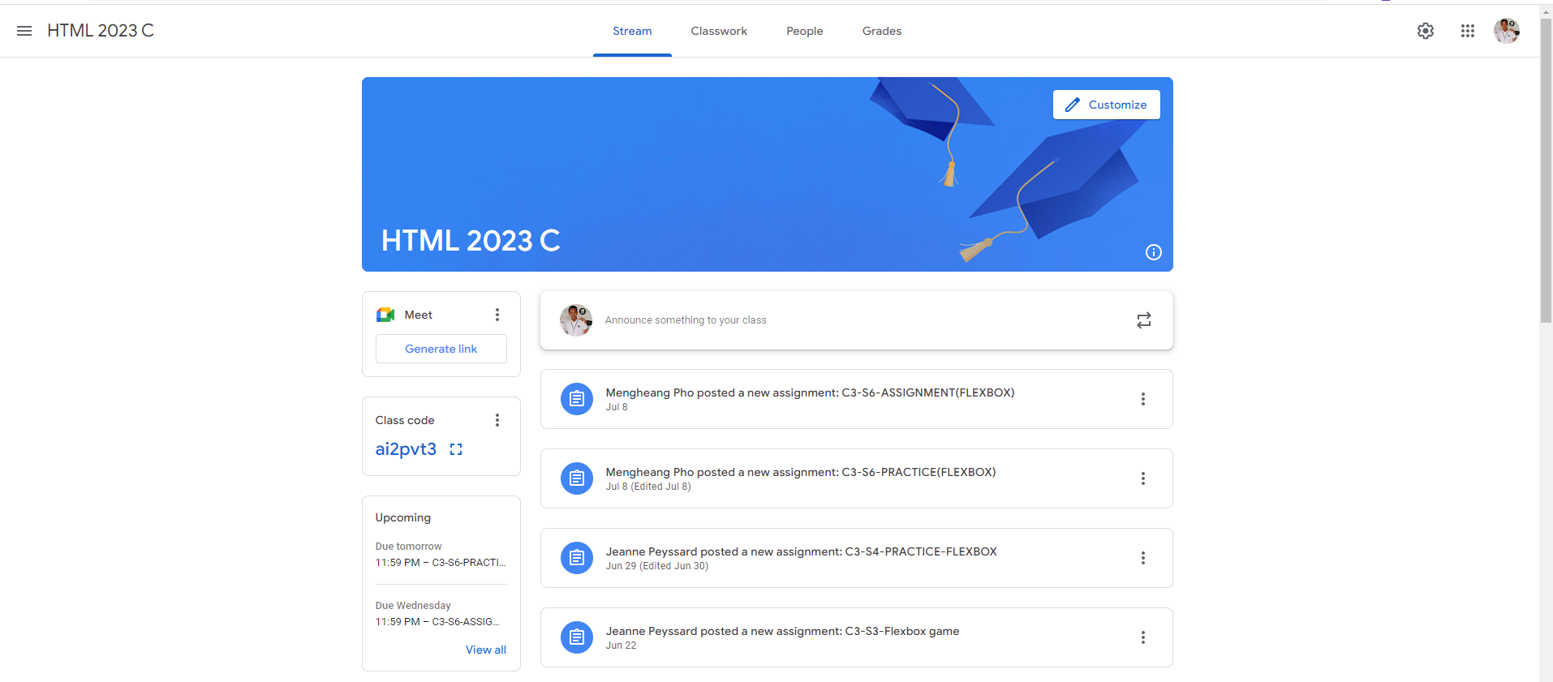
Identify root components of website below

Slide 2
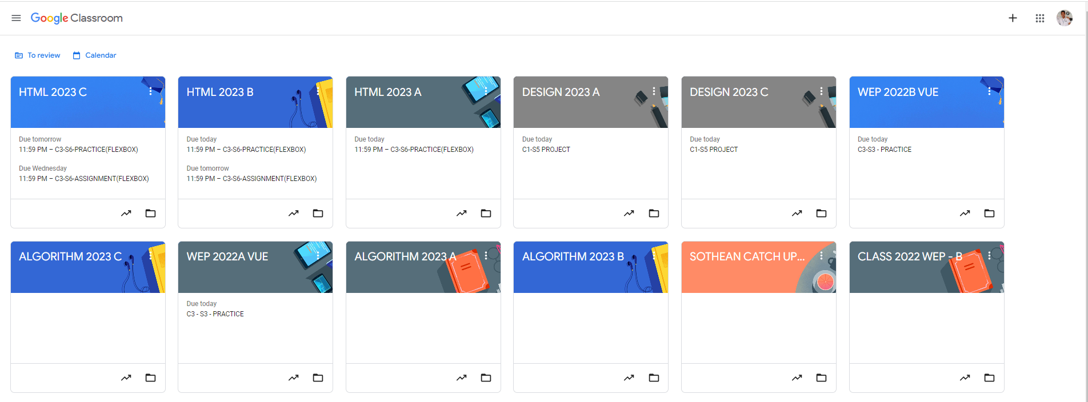
Root div
- Height: 100vh
content
nav
Flex: 0
header
Flex: 0
Flex: 1

Slide 3
Container
Con
NAV
Main
The first root container is the Container and in that container it contain two more div which are head Nav and Main

Slide 4
NAV
Nav
Nav-left
Nav-Center
Nav-Right
profile
In Nav there are three more containers that container element in it
Nav left contain a more button and The Name
Nav center contain four p text
Nav right contain two icon and a container which is for profile picture

Slide 5
Main
HEAD
Main-body
In Main container, It contain two more container which are Head and Main body.

Slide 6
Main body
Side-bar
Main-content
There are two more containers in Main body. They are Side bar and Main content

Slide 7
Side-bar
Main-content
Meet
Announcement-box
Content-box
Class-code
Content-box
Upcoming
Content-box
Content-box
Side-bar contains three more container which are Meet, Class-code and Upcoming.
Main-content contains five more container and four of them are basically the same so I name them the same as Content-box and the difference one is Announcement-box

